Slide 1
Pastoring Professionals
Jeff Haanen Brian Gray
Executive Director / CEO 52890 Fellowship Director / COO

Slide 2
1. Visit Your Parishioners in the Workplace
Category: Pastoral Counseling / City Engagement
Theological Justification: “Christ himself gave the apostles, the prophets, the evangelists, the pastors and teachers, to equip his people for works of service, so that the body of Christ may be built up,” Ephesians 4:11-12
Example: Dr. Don Sweeting, Cherry Creek Presbyterian; Ask 4-part gospel questions
Rhythm: 2-4x/yr.

Slide 3
2. Host a Commissioning Service for Laity in the Workplace
Category: Mission
Theological Justification: “As the Father has sent me, even so I am sending you” John 20:21; “But you are a chosen people, a royal priesthood, a holy nation…” 1 Peter 2:9
Example: http://centerforfaithandwork.com/article/commissioning-service-christians-workplace
Rhythm: 2x/year

Slide 4
3. Use Workplace Illustrations in Sermons
Category: Preaching
Theological Justification: Jesus’ Parables
Example: “His Story, Our Stories: Encountering God Through Your Work”; sermon checklist
Rhythm: Weekly

Slide 5
4. Pray for People in Different Industries
Category: Liturgy
Theological Justification: “Ask the Lord of the harvest, therefore, to send out workers into his harvest field,” Matthew 9:38; “Each of you should use whatever gift you have received to serve others, as faithful stewards of God's grace in its various forms,” 1 Peter 4:10
Example: New City Commons Vespers; http://www.washingtoninst.org/category/do-not-archive/prayercollects/
Rhythm: Seasonal

Slide 6
5. Select Worship Music that Affirms Vocation & Creation
Category: Worship
Theological Justification: “For God was pleased to have all his fullness dwell in him, and through him to reconcile to himself all things, whether things on earth or things in heaven, by making peace through his blood, shed on the cross,” Colossians 1:19-20; “For we are God’s handiwork, created in Christ Jesus to do good works, which God prepared in advance for us to do,” Eph. 2:10.
Example: Porter’s Gate: Work Songs https://www.portersgateworship.com/music-vol1
Rhythm: 1-2x/month

Slide 7
6. Select Small Group Materials on Work, Calling, and Culture
Category: Discipleship
Theological Justification: “Jesus replied: "'Love the Lord your God with all your heart and with all your soul and with all your mind.’ This is the first and greatest commandment. And the second is like it: 'Love your neighbor as yourself.’”
Example: https://scatter.org
Rhythm: 1-2x/year per group

Slide 8
7. Host All-of-Life Interviews in Your Worship Service
Category: Discipleship/Mission
Theological Justification: Creation, Fall, Redemption
Example: Trevor Lee, Trailhead Church: Redemption Church, Tempe, Arizona
Rhythm: Monthly

Slide 9
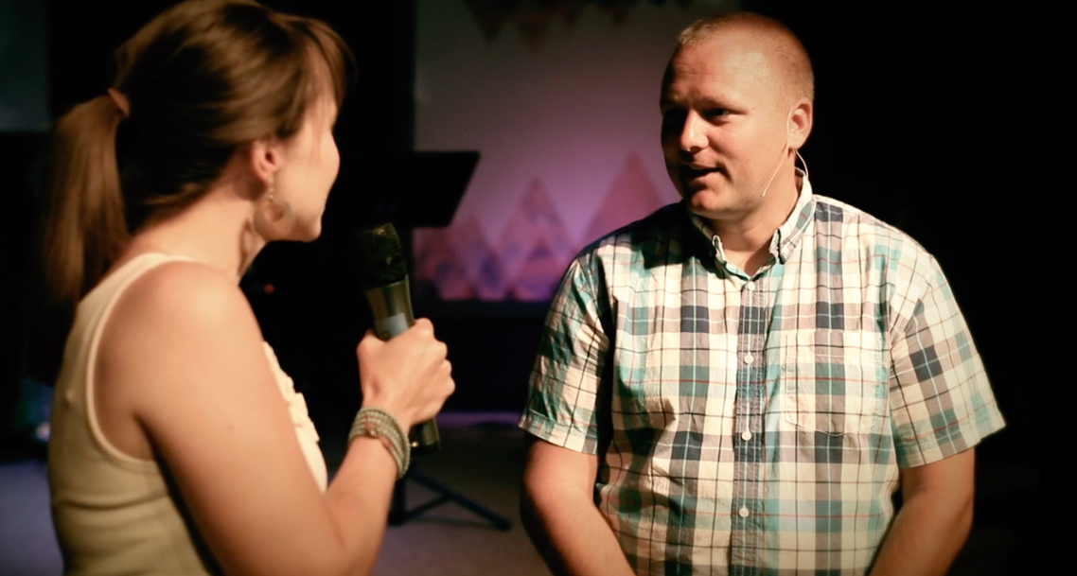

Slide 10
Pastoring Professionals
Jeff Haanen
Executive Director / CEO

